Slide 1

ESD
Section: G4
Members: Gerard Tan, Andrew Liew, Quok Juin, Andrew Woon, Gloria Soh

Slide 2
Solution Scoping
Problem
Flight delays cause airlines losses of as much as $8 billion yearly as an industry. The handling of flight delays is plagued by high cost and inefficiencies due to the lack of a unified interface. Currently, in the delay management plan, the staff manually accesses the Amadeus API to retrieve other available flights, call hotels to make bookings for passengers and manually issue vouchers.
Solution
To create a unified interface which integrates multiple microservices with each microservice specializing in one aspect of delay management. This simplifies the workflow of the staff on duty
Notes:
Airlines lack a unified interface to manage all aspects of the delay on the ground and often resort to several disparate systems.
Time saved in efficiently serving each passenger can help airlines to reduce costs during a delay and ensure closer adherence to airline policy
Well-handled delays improve the customer’s perception of the airline and helps them retain loyal customers

Slide 3
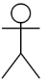
Solution Design
Manager
Docker Container
Staff
Kong API Gateway
Flight.html
Index.html
Service_recovery
.html
Manager.html
AMQP
Flight
Passenger
Service Recovery
Payment
Flight Status
Amadeus API
Gmail API
Stripe API

Slide 4
Presented Scenario -
Flight Staff:
Flight Staff uses Recovery module to check for Passengers Profile/Entitlement
Flight staff checks for passenger’s current vouchers
Flight Staff issues vouchers as per Business rules
Flight Staff books flight for eligible passengers
Flight Manager:
Flight Manager Declares Flight is delayed
Service Recovery Module is activated
Flight Manager Creates Public Announcement
Flight Manager Edits Voucher Entitlements as per Business Rules
Passenger:
5. Goes to Counter staff to request for delay entitlements
Notes:
To put the presented scenario

Slide 5
Presented Scenario - Cont
Service Staff
Redeem voucher through QR Code
Finance
Retrieves all payment info through CSV File
Upload confirmed Payment CSV and pay vendors through Stripe
Payments sent through AMQP
Notes:
To put the presented scenario

Slide 6
Presented Scenario - Cont
Service Staff
Redeem voucher through QR Code
Finance
Retrieves all payment info through CSV File
Upload confirmed Payment CSV and pay vendors through Stripe
Payments sent through AMQP
Notes:
To put the presented scenario

Slide 7
Beyond the Labs
Integrated External APIs - [Amadeus, Gmail, Stripe]
Oauth Authentication
Kong API Gateway
QR Code Implementation
Multiple Docker Containers (Cross Device Communication)
Image Voucher Creation
Auto report generation of CSV file for voucher payment
Moving Announcements
Notes:
To put the presented scenario

Slide 8

Overall Business Scenario
User Scenarios
Staff retrieves passenger profile
Staff checks on possible alternative flight changes and books new flight
Staff requests for hotel accommodation and meal vouchers or other forms of compensation for passenger
Staff checks eligibility and issues vouchers
Manager issues flight delay message or flight delay plan

Slide 9
Scenario Overview Diagram – Staff retrieves passenger profile
Trigger: Customer approaches staff at the counter
Staff scans passenger’s ticket to retrieve his/her profile
Passenger’s profile includes current particulars, flight details and voucher eligibility.

Slide 10
Scenario Overview Diagram – Staff retrieves passenger profile
5. Receive service recovery vouchers issued to passsenger
Service Recovery
4. Request service recovery vouchers issued to passenger
1. Scans pax ticket
Delay System UI
2. Request Passenger details
Passenger
8. Display pax details
Staff
3. Return Passenger details
7. Return Flight details for passenger
Flight
6. Request Flight details for passenger

Slide 11
Scenario Overview Diagram – Check for alternative flight
Trigger: Customer wants to change flight and not wait
Staff scans passenger’s ticket to retrieve details
Staff agent checks for eligibility to change flights based on delay plan
If eligible, check if customer okay to fly on next flight on same airline.
If not eligible, inform customer of reason and offer alternatives
If okay to fly on same airline, book onto next available flight on same airlines
If not okay, check for availability on other airlines using Amadeus API
Book customer onto flight

Slide 12
Scenario Overview Diagram – Staff checks on possible alternative flights
and books new flight
Staff
1. Scan pax ticket
9. Confirm flight
8. Return flight options
9. Return confirmed flight booking
Delay System UI
Passenger
2. Request for current flight booking and alternative flights
10. Create flight booking
7. Return available flights
5. Request flights available given the destination
4. Return passenger’s details
Amadeus API
Flight
HTTP
6. Return available flights
3. Request passenger’s details

Slide 13
Scenario Overview – Staff requests for hotel accommodation and meal vouchers or other forms of compensation for passenger
Trigger: Customer wants to book a hotel and take the flight tomorrow
Staff scans passenger’s ticket to retrieve details
Staff checks for existing flight booking for following day
Staff checks hotel eligibility
If eligible, book hotel & create transport vouchers
If not eligible, offer lounge card and meal vouchers
System issues bookings/vouchers

Slide 14
Scenario Overview Diagram – Staff requests for hotel accommodation
and meal vouchers or other forms of compensation for passenger
Passenger
3. Query Passenger Eligibility
2. Request hotel booking and vouchers
10. Create hotel booking and/or vouchers
1. Scan pax ticket
9. Confirm hotel booking
6. Return passenger eligibility
Delay System UI
Service Recovery
HTTP
8. Display hotel booking confirmation
7. Issue hotel booking confirmation and vouchers
Staff
4. Query new flight booking status
Flight
5. Return new flight booking status

Slide 15
Scenario Overview – Create service recovery vouchers
Trigger: Customer wants to get service recovery vouchers
Staff scans customer ticket to retrieve details
Staff checks for eligibility to issue vouchers
If eligible, create and print out vouchers / email to customer
If not eligible, inform customer of reason and offer alternatives

Slide 16
Scenario Overview Diagram – Create service recovery vouchers
1. Scan pax ticket
6. Select voucher
2. Check Eligibility for Voucher
7. Create Service Recovery Voucher
3. Query Passenger Eligibility
Service Recovery
Passenger
Delay System UI
HTTP
5. Return voucher eligibility
8a. Issue Service Recovery Voucher
4. Return passenger eligibility
Staff
8. Display voucher
8b. Request for email to be sent to passenger
Email API

Slide 17
Scenario Overview – Manager issues flight delay message or flight delay plan
Trigger: Manager wants to update flight delay message (for passengers) or plan (for staff)
Manager issues flight delay message or staff using UI
Customer service agents UI will request and display updated information
Flight delay information UI will request and display updated information
Flight Status Microservice will send updated delay plan to Service Recovery and Flight microservice

Slide 18
Scenario Overview Diagram – Manager issues flight delay message or flight delay plan
4. Flight disruption update will be sent if necessary (customers only)
1. Input flight message or flight plan
2. Create new flight message or flight plan
Flight Status
Email API
Delay System UI
HTTP
Manager
5a. Display flight message/flight plan
3. Send updated flight message or flight plan to all staffs UI
AMQP
5b. Display flight message/flight plan
Staff
Flight
Service Recovery

Slide 19
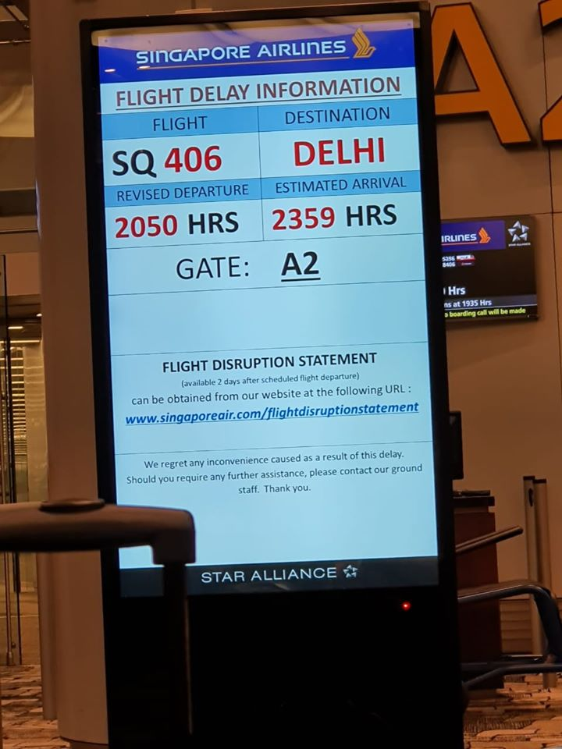
Flight Status Board
1. Request for flight status update
Flight Status
Flight Status Board UI
HTTP
Passenger
2. Send updated flight status

Slide 20
Technical Overview Diagram
Microservice: Passenger
Retrieve all records
[GET] /pax
View records of passenger
[GET] /pax/{passenger_id}
Modify passenger record
[POST] /pax/modify
Database
Passenger
PID (INT)
PNR (INT)
Family Name (VARCHAR)
Given Name (VARCHAR)
Title (VARCHAR)
Passport Number (VARCHAR)
eTicket Number (VARCHAR)
Contact Number (VARCHAR)
Email (VARCHAR)
Seat Number (VARCHAR)
Fare Class (VARCHAR)
Remarks (VARCHAR)

Slide 21
Flight Delay Management UI
Staff retrieves passenger profile
Alternative flight booking
Book Hotel
Passenger
Retrieve all records
[GET] /pax
View records of passenger
[GET] /pax/{passenger_id}
Modify passenger record
[POST] /pax/modify
Passenger
PID (INT)
PNR (INT)
Family Name (VARCHAR)
Given Name (VARCHAR)
Title (VARCHAR)
Passport Number (VARCHAR)
eTicket Number (VARCHAR)
Contact Number (VARCHAR)
Email (VARCHAR)
Seat Number (VARCHAR)
Fare Class (VARCHAR)
Remarks (VARCHAR)

Slide 22
Technical Overview Diagram
Microservice: Flight
Retrieve all records for pax
[GET] /flight-records/{passenger_id}
Modify passenger record
[POST] /flight-records/modify
Retrieve flight routings
[GET] /flight-records/search
Book flight for pax
[POST] /flight-records/book
Search for other flights
[POST] /flight-records/search-external
Database
Booked Tickets
PID (INT)
Dep Apt (VARCHAR)
Dep Date (DATE)
Dep Time (TIME)
Arr Apt (VARCHAR)
Arr Date (DATE)
Arr Time (TIME)
Airline (VARCHAR)
Travel Time (VARCHAR)
Fare Class (VARCHAR)
Ticket Status (VARCHAR)
Remarks (VARCHAR)
Database
Flight List
FID (INT)
Dep Apt (VARCHAR)
Dep Date (DATE)
Dep Time (TIME)
Arr Apt (VARCHAR)
Arr Date (DATE)
Arr Time (TIME)
Airline (VARCHAR)
Travel Time (VARCHAR)

Slide 23
Flight Delay Management UI
Staff retrieves passenger profile
Alternative flight booking
Book Hotel
Flight
Retrieve flight routings
[GET] /flight-records/search
Book flight for pax
[POST] /flight-records/book
Search for other flights
[POST] /flight-records/search-external
Retrieve all records for pax
[GET] /flight-records/{passenger_id}
Modify passenger record
[POST] /flight-records/modify
Booked_Flight
Flight_List
PID (INT)
Dep Apt (VARCHAR)
Dep Date (DATE)
Dep Time (TIME)
Arr Apt (VARCHAR)
Arr Date (DATE)
Arr Time (TIME)
Airline (VARCHAR)
Travel Time (VARCHAR)
Fare Class (VARCHAR)
Ticket Status (VARCHAR)
Remarks (VARCHAR)
FID (INT)
Dep Apt (VARCHAR)
Dep Date (DATE)
Dep Time (TIME)
Arr Apt (VARCHAR)
Arr Date (DATE)
Arr Time (TIME)
Airline (VARCHAR)
Travel Time (VARCHAR)

Slide 24
Technical Overview Diagram
Microservice: Service Recovery
Retrieve all vouchers for pax
[GET] /service-vouchers/{passenger_id}
Retrieve voucher by ID
[GET] /service-vouchers/{voucher_id}
Retrieve all vouchers
[GET] /service-vouchers
Modify voucher
[POST] /service-vouchers/modify
Issue new voucher
[POST] /service-vouchers/issue
Check hotel availability
[GET]/service-vouchers/hotel/<hotel_id>
Add new hotel
[POST]/service-vouchers/hotel/add
Modify available rooms
[POST]/service-vouchers/hotel/modify
Database
Vouchers
VID (VARCHAR)
PID (INT)
Voucher Type (VARCHAR)
Issue Datetime (DATETIME)
Entitlement (VARCHAR)
Remarks (VARCHAR)
Database
Hotel
HID (INT)
Hotel Name (VARCHAR)
Hotel Address (VARCHAR)
Economy Rooms Available (INT)
Business Rooms Available (INT)
First Rooms Available (INT)
Total Economy Rooms (INT)
Total Business Rooms (INT)
Total First Rooms (INT)
Remarks (VARCHAR)

Slide 25
Flight Delay Management UI
Staff retrieves passenger profile
Alternative flight booking
Book Hotel
Service
Recovery
Issue new voucher
[POST] /service-vouchers/issue
Check hotel availability
[GET]/service-vouchers/hotel/<hotel_id>
Add new hotel
[POST]/service-vouchers/hotel/add
Retrieve all vouchers for pax
[GET] /service-vouchers/{passenger_id}
Retrieve voucher by ID
[GET] /service-vouchers/{voucher_id}
Retrieve all vouchers
[GET] /service-vouchers
Modify voucher
[POST] /service-vouchers/modify
Modify available rooms
[POST]/service-vouchers/hotel/modify
Vouchers
Hotel_List
VID (VARCHAR)
PID (INT)
Voucher Type (VARCHAR)
Issue Datetime (DATETIME)
Entitlement (VARCHAR)
Remarks (VARCHAR)
HID (INT)
Hotel Name (VARCHAR)
Hotel Address (VARCHAR)
Economy Rooms Available (INT)
Business Rooms Available (INT)
First Rooms Available (INT)
Total Economy Rooms (INT)
Total Business Rooms (INT)
Total First Rooms (INT)
Remarks (VARCHAR)

Slide 26
Technical Overview Diagram
Microservice: Flight Status
Retrieve all current flight messages
[GET/m] /flight-statusessage
Add new flight message
[POST] /flight-status/new-message
Retrieve flight delay status
[GET] /flight-status/{flight_no}
Modify flight status
[GET] /flight-status/modify/{flight_no}
Add new delay plan
[POST] /flight-status/delay-plan
View delay plan
[GET] /flight-status/delay-plan/{flight_no}
Database
Flight Messages
MID (INT)
Message (VARCHAR)
Issue Datetime (DATETIME)
Active (Boolean)
Database
Plan
PlanID (INT)
Flight Number (INT)
Delay Status (Boolean)
Issue Datetime (DATETIME)
Message (VARCHAR)
Active (Boolean)

Slide 27
Flight Delay Management UI
Staff retrieves passenger profile
Alternative flight booking
Book Hotel
Flight
Status
Modify flight status
[GET] /flight-status/modify/{flight_no}
Add new delay plan
[POST] /flight-status/delay-plan
View delay plan
[GET] /flight-status/delay-plan/{flight_no}
Retrieve all current flight messages
[GET] /flight-status/message
Add new flight message
[POST] /flight-status/new-message
Retrieve flight delay status
[GET] /flight-status/{flight_no}
Message
Plan
MID (INT)
Message (VARCHAR)
Issue Datetime (DATETIME)
Active (Boolean)
PlanID (INT)
Flight Number (INT)
Delay Status (Boolean)
Issue Datetime (DATETIME)
Message (VARCHAR)
Active (Boolean)

Slide 28
The End

